Slide 1
THE ENTREPRENEURIAL OPPORTUNITY ​IN MALAWI’S DIGITAL TRANSFORMATION: MODELLING ​PUBLIC INFORMATION MANAGEMENT SYSTEMS ​ FOR DEVELOPMENT​
MSc Thesis Defense Presentation at the Malawi University of Science and Technology on the 1st of July, 2024
Name of Candidate: Nthanda Manduwi
Supervisors: Prof. A. Maluwa (Malawi University of Science & Technology)
Dr. A. Mtenje-Mkochi (Malawi University of Science & Technology)

Slide 2
Presentation Outline
Introduction​
Background​
Problem Statement​
Study Objectives​
Literature Review​
Methodology​
Results Analysis​
Discussions​
Conclusions and Recommendations

Slide 3
Introduction
2019 - a new pandemic disease: COVID-19
Devastating impacts on livelihoods and business performance
Highlighted the vast digital divide between poor:rich, rural:urban, and advanced:developing economies
Also presented an opportunity for entrepreneurs and innovators
Malawi adopted digital transformation as one of its strategies - MW 2063
MACRA developing a Digital Innovation and Entrepreneurship Bill
For global south to make a significant strides to reduce gap with west - need to think of digital inclusion
IT and businesses more integrated
Several on-going Donor/IGO-funded projects in support of Malawi’s digital transformation
Notes:
On the 17th of November 2019, the world experienced a new pandemic disease, the Covid-19, after the first case of COVID-19 was confirmed in Wuhan, China​
The COVID-19 pandemic presented devastating impacts on livelihoods and business performance, and it also highlighted the vast digital divide between the poor and the rich, between rural and urban areas, and between advanced and developing economies (Beaunoyer & Sophie Dupere, 2020)​
Malawi has adopted digital transformation as one of its strategies towards an inclusively wealthy and self-reliant Malawi by 2063.​
For the global south to make a significant stride that reduces that gap with the west, there is a need to think of digital inclusion. Digital inclusion comprises policies and actions that mitigate the significant, interrelated problems of the digital divide and digital literacy (Manda & Beckhouse, 2018). ​
Specifically, in light of the pandemic, digital technologies promote learning, working, and interacting with each other (World Bank, 2016).

Slide 4
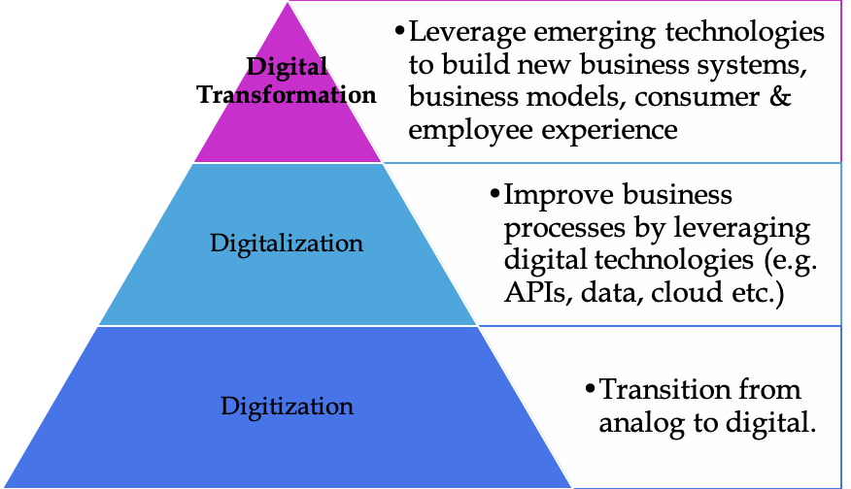
Background
8-9 years of the software development industry
Digital tools used to collect, store, analyse, and share information digitally have spread quickly
A quarter billion of Africans lived in a single mobile network operator market
Data expensive - 1GB of data can amount to 7.7% of the average African’s income​
(World Bank, 2021) recommends Malawi should develop the digital economy
Notes:
According to Hara (2021), Malawi has had an active software development community for over a decade, but it is in the last
8-9 years that the software development industry has substantially matured.​
The World Bank in 2016 said Digital technologies, the internet, mobile phones, and all the other tools used to collect, store, analyse, and share information digitally have spread quickly.
As of 2021, a quarter billion of Africans lived in a single mobile network operator market. Data is very expensive - where 1GB of data can amount to 7.7% of the average African’s income. ​
In the quest for digital transformation, the (World Bank, 2021) goes further to recommend that Malawi should develop the digital economy to not only diversify but also strengthen economic growth, job creation, and innovation. ​
To achieve digital transformation, there is a need for effective creation and uptake digital information management systems.

Slide 5
Problem Statement
“Entrepreneurship is the engine of innovation”
(Hindle & Yencken, 2004)
Few studies conducted in Malawi on the actual status of digitisation and innovation in Malawi.
Global context applied to provide local solutions​
Study aims to contribute to the knowledge on the entrepreneurial opportunities which arise to model information management systems and help the public and private sector digitalise
Notes:
COVID-19 highlighted the digital divide in Africa, and presents an opportunity for entrepreneurs and innovators in countries like Malawi which are left so far behind in the digital transformation.​
To achieve effective digitalisation, there is a need for business and IT leaders to work together to create sustainable innovations and businesses (Swift, 2021). ​
(IT and the business need a shared language – the work being done is ever more integrated (Swift, 2021). ​
By leveraging ICT, tech-entrepreneurship, and improving digital skills, there is potential for Malawi’s private sector to contribute substantively to economic growth, nurture innovation, catalyse job creation, and attain better access to markets and information. ​
There are several on-going projects funded by the international donor and International non-governmental organization (INGO) community in support of Malawi’s digital transformation. ​
There are few studies conducted in Malawi on the actual status of digitisation and innovation. Global context is often applied in the quest to provide local solutions.​
This study aims to contribute to the knowledge on the entrepreneurial opportunities which arise to model information management systems and help the public and private sector digitalise. ​

Slide 6
Objectives
General Objective​
To investigate the determinants of sustainable information management systems uptake for development in Malawi
Specific Objectives​
To determine the impact of TOEI factors on the creation of digital information management tools and systems
2.To establish the relationship between TOEI factors and use of digital information management tools and systems

Slide 7
Hypotheses
Hypothesis 1
Null Hypothesis (H₀): TOEI factors have no significant impact on the creation of IMS in Malawi.
Alternative Hypothesis (H₁): TOEI factors have a significant impact on the creation of IMS in Malawi.
Hypothesis 2
Null Hypothesis (H₀): There is no significant relationship between TOEI factors and the use of IMS in Malawi.
Alternative Hypothesis (H₁): There is a significant relationship between TOEI factors and the use of IMS in Malawi.
Notes:
Hypthesis 1
Null Hypothesis (H₀): TOEI factors have no significant impact on the creation of digital information management tools and systems in Malawi.
Alternative Hypothesis (H₁): TOEI factors have a significant impact on the creation of digital information management tools and systems in Malawi.
Hypothesis 2
Null Hypothesis (H₀): There is no significant relationship between TOEI factors and the use of digital information management tools and systems in Malawi.
Alternative Hypothesis (H₁): There is a significant relationship between TOEI factors and the use of digital information management tools and systems in Malawi.

Slide 8
Literature Review - Theoretical Framework​
Notes:
The theoretical framework of this study focuses on the impact of digitalisation on entrepreneurial models by (Bouwman, Nikou, Molina-Castillo, & Reuver, 2017). According to (Bouwman, Nikou, Molina-Castillo, & Reuver, 2017) , innovation activity, strategy, competitive intensity and technology turbulence lead to business model experimentations, which affects business model practices, leading to innovativeness that impacts overall performance. ​

Slide 9
Literature Review - Conceptual Framework​
Innovativeness
IT Ability
IT Experience
Technology Readiness
Firm Size
Individual
Factors
Organisational
Factors
IMS
Creation
Perceived Benefits
Compatibility
Cost
Consumer Pressure
Competitor Pressure
External Support
Technological
Factors
Environmental
Factors
Notes:
Theory of Reasoned Action (TRA)
Theory of Planned Behaviour (TPB)
Technology Acceptance Model (TAM)
Diffusion of Innovations Theory
Technology-Organization-Environment Framework (TOE)
Conceptual Framework​
The Technology-Organization-Environment (TOE) framework was developed initially by Tornatzky, Fleischer, and Chakrabarti (1990) in order to describe the influence of contextual factors in adoption of an innovation.​
Criticisms of the TOE Framework in include that is that this model ignores factors related to individual attributes concerning employees and managers.​
The advanced TOE framework takes this limitation into consideration. In addition to considering technological, organizational, and environmental contexts, there are relevant factors related to the individual that affect SMEs adoption of information management systems ​

Slide 10
Methodology
The research adopted a cross-sectional study design and utilised quantitative research method
Utilising the SLOVIN’S FORMULA: n = N / (1 + N(e²));
where n = sample size, N = population size, and e =desired level of precision. In this study, N = 19,800,000, and e = 0.05; a sample size of 400 was estimated
Data was collected from 461 respondents,​ of whom 63 identified as IMS Creators, 363 identified as IMS Users, and 35 identified as both users and creators of IMS
Notes:
The research adopted a cross-sectional study design and utilized quantitative research method. Utilising the Slovin's formula, a sample size of 400 was estimated. The formula is given by n = N / (1 + N(e^2)), where n is the sample size, N is the population size, and e is the desired level of precision. At the time of this study, the population of Malawi was 18,000,000, and our e was 0.05.
There were a total of 461 respondents, which included creators and users of IMS from Secondary School to Postgraduate (out-of-school) level. ​
The data collected were on the factors affecting both the creation and the use (adoption/uptake) of digital IMS. Data were collected using a survey method. A Structured questionnaire was used to collect data from research participants. The data collected, which were numeric were on the factors affecting both the creation and the use (adoption/uptake) of digital information management systems in likert-ordinal format – specifically on technological, organisational, environmental, and individual factors.

Slide 11
Methodology
The data collected, which was numeric, was on the factors affecting both the creation and the use (adoption/uptake) of digital information management systems in likert-ordinal format – specifically on technological, organisational, environmental, and individual factors
The fitted binary logistic regression models was therefore of the form:​
Logit (P) = ln(p/1-p) = 𝛽₀ + 𝛽₁Benefits_{i} + 𝛽₂Compatibility_{i} + 𝛽₃Cost_{i} + 𝛽₄TechReadiness_{i} + 𝛽₅FirmSize_{i} + 𝛽₆CSPressure_{i} + 𝛽₇CPressure_{i} + 𝛽₈ExtSupport_{i} +𝛽₉Innovativeness_{i} + 𝛽₁₀ability_{i} + 𝛽₁₁Experience_{i} + ε_{ijkl} ……………………………………………………………Equation 1 and 2
Notes:
TECHNOLOGICAL:
Perceived benefits
Perceived compatibility
Cost
ORGANISATIONAL:
Technology Readiness
Firm Size
ENVIRONMENTAL:
Consumer Pressure
Competitor Pressure
External support
INDIVIDUAL:
Innovativeness
IT Ability
IT Experience

Slide 12
Methodology
The data collected was on the factors affecting both the creation and the use of digital IMS. Data was collected using a survey method
A Structured questionnaire was used. The survey was conducted fully online
There were 3 surveys created via Google Forms:
For IMS Creators
For IMS Users
For those who identified as both IMS Creators and Users
Data collected in 3 was then split into datasets 1 and 2
Notes:
The data collected was on the factors affecting both the creation and the use of digital IMS. Data was collected using a survey method
A Structured questionnaire was used. The survey was conducted fully online
There were 3 surveys created via Google Forms:
For IMS Creators
For IMS Users
For those who identified as both IMS Creators and Users
Data collected in 3 was then split into datasets 1 and 2

Slide 13
Methodology – Survey (Research) Questions
1. How do TOEI (Technology, Organizational, Environmental, and Individual) factors impact the creation of digital information management tools and systems in Malawi?
2. What is the relationship between TOEI (Technology, Organizational, Environmental, and Individual) factors and the use of digital information management tools and systems in Malawi?

Slide 14
Methodology – Data Analysis
Descriptive Statistics for Demographic Data
>95% in Malawi
Creators:70+/-% male, 20-40% between 20-29
Users: 52% female, 52% secondary school level
Correlation Matrix relating all regressor variables and response variables.
Using Pearson correlation for scale variables, and chi-square for likert-ordinal scale responses
The test level of significance was r>50, and p<0.05
Fitted the data for significant regressors into the binary logistic regression of the response on the regressors
Computed the odd-ratios for the significant predictors
Notes:
In this study, descriptive statistics were employed to analyze the demographic data, providing a comprehensive summary of the key characteristics of the sample population.
The three surveys were groups into two outputs: creators and users.​
The respondents were both male and female of various age groups, with different levels of academic experience. The demographics were also collected and analysed.​
To understand the relationships between all regressor and response variables, a correlation matrix was constructed.
For scale variables, Pearson correlation coefficients were calculated, while chi-square tests were utilized for Likert-ordinal scale responses.
The level of significance for these tests was set with a correlation coefficient threshold of r > 0.50 and a p-value of less than 0.05.
Data for significant regressors were then fitted into a binary logistic regression model to evaluate the influence of the regressors on the response variable.
Significant predictors identified from the logistic regression analysis were further analyzed through the computation of odds ratios, providing insights into the magnitude of their effects on the response variable.

Slide 15
Methodology – Ethical Considerations
The study was reviewed and approved by MUSTREC (MUSTREC Ref. No. P.04/2023/044)
There was a requirement of informed consent
Participants were assured of privacy and confidentiality
Participation was entirely voluntary
Respondents were not intimidated or coerced into participating in the research
Notes:
The study was reviewed and approved by MUSTREC (MUSTREC Ref. No. P.04/2023/044). Prospective respondents were fully informed about the procedures and risks involved in the research. There was a requirement of informed consent - before taking the survey, the respondents were provided with an introduction to the research, and a consent form. By taking the survey, they consented to their responses being used in the research. Participants were assured of privacy and confidentiality such that information was treated in strict confidence, and participants’ identities were not disclosed. Participation was entirely on a voluntary basis. Respondents were not intimidated or coerced into participation in the research. Further, respondents were guaranteed discretion, such that the information would not be made available to anyone who is not directly involved in the study.

Slide 16
Results – Creation of IMS
IMS Creation | Coef.​ | St.Err.​ | t-value​ | p-value​ | [95% Conf​ | Interval]​ | Sig​
Perceived Benefits2​ | .307​ | .206​ | -1.76​ | 0.079​ | .082​ | 1.145​ | ​
Perceived Benefits3​ | .278​ | .175​ | -2.04​ | 0.042​ | .081​ | .954​ | **​
Perceived Benefits4​ | .3​ | .192​ | -1.88​ | 0.060​ | .085​ | 1.053​ | ​
Perceived Benefits5​ | .172​ | .111​ | -2.72​ | 0.006​ | .048​ | .611​ | ***​
Cost3​ | 2.313​ | .829​ | 2.34​ | 0.019​ | 1.145​ | 4.67​ | **​
Cost4​ | 3.714​ | 1.425​ | 3.42​ | 0.001​ | 1.751​ | 7.878​ | ***​
Cost5​ | 3.337​ | 1.297​ | 3.10​ | 0.002​ | 1.558​ | 7.148​ | ***​
Tech Readiness2​ | 1.558​ | .582​ | 1.19​ | 0.235​ | .749​ | 3.239​ | ​
Firm Size5​ | 2.321​ | .66​ | 2.96​ | 0.003​ | 1.329​ | 4.052​ | ***​
Competitor Pressure3​ | 1.377​ | .384​ | 1.15​ | 0.252​ | .797​ | 2.378​ | ​
Competitor Pressure5​ | 2.759​ | .803​ | 3.49​ | 0.001​ | 1.559​ | 4.88​ | ***​
External Support2​ | 2.517​ | .82​ | 2.83​ | 0.005​ | 1.329​ | 4.767​ | ***​
Innovativeness2​ | 1.526​ | .628​ | 1.03​ | 0.304​ | .682​ | 3.418​ | ​
Innovativeness3​ | 1.229​ | .392​ | 0.65​ | 0.518​ | .658​ | 2.296​ | ​
Innovativeness5​ | 1.777​ | .52​ | 1.97​ | 0.049​ | 1.002​ | 3.152​ | **​
IT Ability3​ | 1.826​ | .531​ | 2.07​ | 0.039​ | 1.032​ | 3.229​ | **​
Constant​ | .186​ | .111​ | -2.81​ | 0.005​ | .058​ | .601​ | ***​
Notes:
*** p<0.01, ** p<0.05​
Seven of the eleven predictors in the IMS Creation study were significant.​

Slide 17
Results – Adoption of IMS
IMS Adoption​ | Coef.​ | St.Err.​ | t-value​ | p-value​ | [95% Conf​ | Interval]​ | Sig​
Perceived Benefits4​ | 2.565​ | .969​ | 2.49​ | 0.013​ | 1.223​ | 5.378​ | **​
Perceived Benefits5​ | 3.297​ | 1.309​ | 3.01​ | 0.003​ | 1.514​ | 7.177​ | ***​
Cost3​ | .344​ | .152​ | -2.41​ | 0.016​ | .144​ | .818​ | **​
Cost4​ | .286​ | .14​ | -2.57​ | 0.01​0 | .11​ | .744​ | **​
Cost5​ | .356​ | .181​ | -2.03​ | 0.042​ | .131​ | .965​ | **​
Customer Pressure4​ | 2.465​ | 1.022​ | 2.18​ | 0.030​ | 1.094​ | 5.557​ | **​
External Support2​ | .375​ | .14​ | -2.62​ | 0.009​ | .18​ | .781​ | ***​
Innovativeness3​ | .113​ | .119​ | -2.07​ | 0.038​ | .014​ | .89​ | **​
Innovativeness4​ | .077​ | .082​ | -2.42​ | 0.016​ | .01​ | .616​ | **​
Innovativeness5​ | .102​ | .109​ | -2.14​ | 0.033​ | .013​ | .828​ | **​
Constant​ | 82.544​ | 87.223​ | 4.18​ | 0.001​ | 10.405​ | 654.84​ | ***​
​
*** p<0.01, ** p<0.05​
Notes:
Besides cost, all the variables considered in the TOEF positively influence the creation and adoption of IMS. The cost of producing IMS positively influences the creation of IMS, while cost of accessing IMS negatively influences adoption of IMS.
The relationship of the regressors with the response variables show that all the regressor variables contained information about the response variables and could therefore be used to predict the response variables.

Slide 18
Results – Odds Ratios in Reduced Model
 | IMS Creation | IMS Adoption
Perceived Benefits2 | -1.812**
Perceived Benefits3 | -1.877**
Perceived Benefits4 | -1.683** | 0.930**
Perceived Benefits5 | -2.271*** | 1.286***
Competitor Pressure4 | 0.741
Firm Size5 | 0.859***
Innovativeness4 | 1.922*** | -2.374**
Customer Pressure4 | -0.958*** | 0.845**
Innovativeness3 | 1.615** | -2.133**
Cost3 | 0.703* | -1.083**
Cost4 | 1.016** | -1.172**
Cost5 | 0.986** | -0.915
Tech Readiness2 | 0.807**
IT Ability3 | 0.705**
External Support2 | 0.970*** | -1.039***
Competitor Pressure5 | 1.442***
Innovativeness2 | 1.766** | -2.039
Innovativeness5 | 2.001*** | -1.829
Competitor Pressure3 | 0.789**
IT Experience5 |  | -0.868**
Constant | -2.782*** | 4.430***

Slide 19
Discussions – TOEI Model Applicable to Malawi
Innovativeness
IT Ability
IT Experience
Innovativeness
IT Ability
IT Experience
Technology Readiness
Firm Size
Technology Readiness
Firm Size
Individual
Factors
Organisational
Factors
Individual
Factors
Organisational
Factors
IMS
Creation
IMS
Adoption
Perceived Benefits
Compatibility
Cost
Consumer Pressure
Competitor Pressure
External Support
Perceived Benefits
Compatibility
Cost
Consumer Pressure
Competitor Pressure
External Support
Technological
Factors
Environmental
Factors
Technological
Factors
Environmental
Factors

Slide 20
Discussions
The TOEI framework was in this study proven to have a positive correlation with IMS uptake in Malawi
The framework has a stronger impact on in-fact IMS creation, but also on uptake. Findings agree with the theoretical model, where digitalisation does show to have impact on entrepreneurial models
For use of IMS, Perceived benefits at the level 5 aka “most likely” have shown to be the most significant, with odds ratio of 1.286
For IMS Creation, several factors are significant, which include innovativeness, cost, competitor pressure, and innovativeness.
88% of Malawians now have access to either 3G or 4G internet connectivity (World Bank, 2021)
Prioritising digital transformation and advancing public information management systems for driving inclusive growth, promoting good governance, and improving well-being of citizens
Notes:
In the developmental context of Malawi, the significance of digital transformation and robust public information management systems cannot be overstated. 88% of Malawians now have access to either 3G or 4G internet connectivity (World Bank, 2021).​ This is an opportunity.
This thesis asserts that prioritising digital transformation and advancing public information management systems in Malawi is paramount for driving inclusive growth, promoting good governance, and ultimately improving the well-being of its citizens. ​
With the increasing penetration of digital technologies, entrepreneurs are leveraging digital platforms to overcome geographical barriers, access global markets, and streamline operations. The intersection of entrepreneurship and digital transformation in Malawi is not merely a means of survival but a catalyst for sustainable economic development. ​
Numerous challenges persist, including inadequate digital infrastructure, limited internet connectivity, and disparities in digital literacy and skills (National Planning Commission, 2021). Regulatory barriers, cybersecurity threats, and the digital divide exacerbate the challenges faced by entrepreneurs in leveraging digital technologies effectively. ​

Slide 21
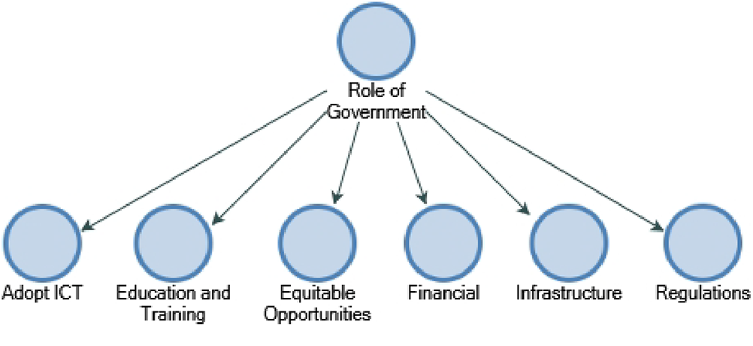
Conclusion & Recommendations
Study confirms that TOEI factors significantly influence the creation of digital information management tools in Malawi.
Correlation between TOEI factors and use of IMS in Malawi.
Stronger correlation between TOEI factors and creation of IMS.
Findings highlight necessity of addressing TOEI factors to foster an environment for digital transformation in Malawi.
A strategic roadmap for stakeholders to enhance policy frameworks and foster digital entrepreneurship
New age of AI - the focus of our efforts should pivot
Notes:
The identification of technological factors such as perceived benefits and cost as primary influencers underscores potential entrepreneurial opportunities in providing innovative IMS solutions that offer clear benefits and cost-effectiveness to organizations in Malawi. ​
In terms of IMS adoption, the findings reinforce the importance of technological factors such as perceived benefits and cost in influencing adoption decisions. This suggests entrepreneurial opportunities in developing and marketing IMS solutions that emphasize their value proposition and affordability, thereby addressing the needs of organizations seeking to adopt such technologies. ​
By synthesizing insights from the TOEI framework analysis, this section offers a strategic roadmap for stakeholders to enhance policy frameworks, foster digital entrepreneurship, and promote effective Information Management Systems (IMS) implementation. ​
Acknowledging the new age of artificial intelligence, the focus of our efforts should pivot towards understanding the intersection of IMS creation and adoption with the dual challenges posed by the emergence of Artificial Intelligence (AI), to address the widening digital divide between the west and the global south. ​

Slide 22
THE ENTREPRENEURIAL OPPORTUNITY ​IN MALAWI’S DIGITAL TRANSFORMATION: MODELLING ​PUBLIC INFORMATION MANAGEMENT SYSTEMS ​ FOR DEVELOPMENT​
THANK YOU FOR YOUR ATTENTION
Nthanda Manduwi
MSc. In Entrepreneurship
(Candidate)

